Slide 1
HOSPITAL AND MEDICAL FACILITIES
-An AI Expert System

Slide 2
content
What is expert system?
Component and Architecture
Knowledge base and Inference Engine
Type of expert system
Problem statement

Slide 3
What is an Expert system ?
Expert systems are a crucial subset of artificial intelligence (AI) that simulate the decision-making ability of a human expert. These systems use a knowledge base filled with domain-specific information and rules to interpret and solve complex problems. Expert systems are widely used in fields such as medical diagnosis, accounting, coding, and even in games.
An expert system is AI software that uses knowledge stored in a knowledge base to solve problems that would usually require a human expert thus preserving a human expert’s knowledge in its knowledge base. They can advise users as well as provide explanations to them about how they reached a particular conclusion or advice.

Slide 4
Component and Architecture
Knowledge Base: The knowledge base represents facts and rules. It consists of knowledge in a particular domain as well as rules to solve a problem, procedures and intrinsic data relevant to the domain.
Inference Engine: The function of the inference engine is to fetch the relevant knowledge from the knowledge base, interpret it and to find a solution relevant to the user’s problem. The inference engine acquires the rules from its knowledge base and applies them to the known facts to infer new facts. Inference engines can also include an explanation and debugging abilities.

Slide 5
Component and Architecture
Knowledge Acquisition and Learning Module: The function of this component is to allow the expert system to acquire more and more knowledge from various sources and store it in the knowledge base.
User Interface: This module makes it possible for a non-expert user to interact with the expert system and find a solution to the problem.
Explanation Module: This module helps the expert system to give the user an explanation about how the expert system reached a particular conclusion.

Slide 6
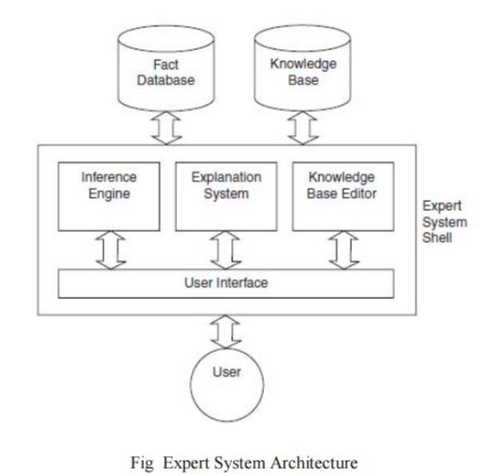
Component and Architecture

Slide 7
Knowledge base and Inference Engine
1. Knowledge Base
The knowledgebase is a type of storage that stores knowledge acquired from the different experts of the particular domain. It is considered as big storage of knowledge. The more the knowledge base, the more precise will be the Expert System.
It is similar to a database that contains information and rules of a particular domain or subject.
One can also view the knowledge base as collections of objects and their attributes. Such as a Lion is an object and its attributes are it is a mammal, it is not a domestic animal, etc.

Slide 8
Knowledge base and Inference Engine
Inference Engine(Rules of Engine)
The inference engine is known as the brain of the expert system as it is the main processing unit of the system. It applies inference rules to the knowledge base to derive a conclusion or deduce new information. It helps in deriving an error-free solution of queries asked by the user.
With the help of an inference engine, the system extracts the knowledge from the knowledge base.
Reasoning Strategies used by Inference Engine:
Forward Chaining and Backward Chaining, which are two fundamental methods for processing information and solving problems in an expert system:

Slide 9
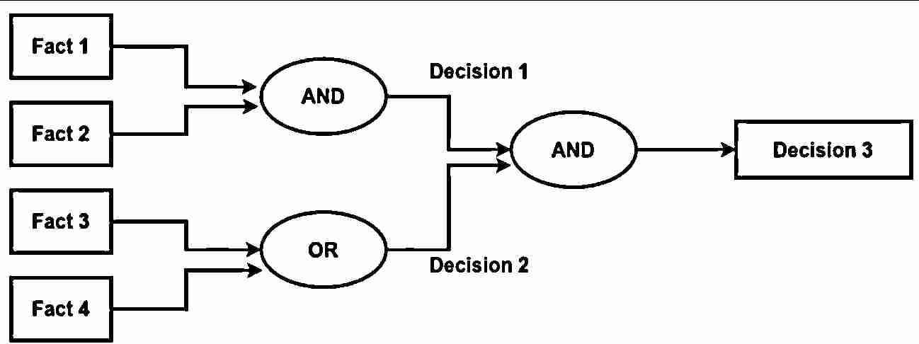
Knowledge base and Inference Engine
1. Forward Chaining
This is a data-driven reasoning approach where the system starts with the available facts and applies rules to infer new facts or conclusions. It’s typically used to predict outcomes or determine what will happen next. An example given is predicting stock market movements.
Fig.1 forward chaining

Slide 10
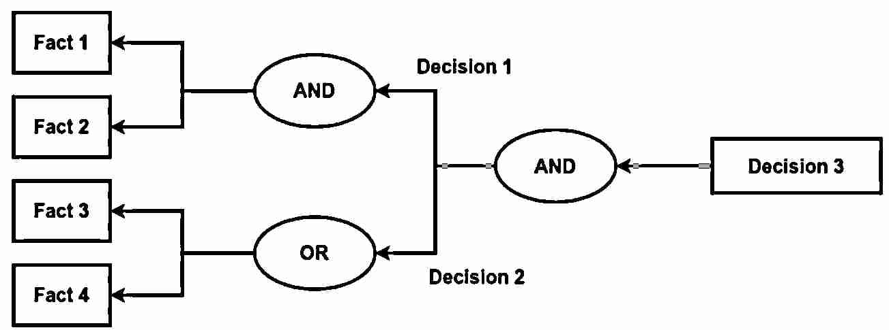
Knowledge base and Inference Engine
2. Backward Chaining
This is a goal-driven reasoning approach where the system starts with a hypothesis or a goal (something to prove) and works backward to determine which facts or conditions would support that conclusion. It’s often used to diagnose issues by determining the cause of an observed effect. The examples provided include diagnosing medical conditions like stomach pain, blood cancer, or dengue.
Fig.3 Backward chaining

Slide 11
Type of expert system
In AI, expert systems are designed to emulate the decision-making abilities of human experts. They are categorized based on their underlying technology and application areas. Here are the primary types of expert systems in AI:
1. Rule-Based Expert Systems
Description: Use a set of “if-then” rules to process data and make decisions. These rules are typically written by human experts and capture domain-specific knowledge.
Example: MYCIN, an early system for diagnosing bacterial infections.
2. Frame-Based Expert Systems
Description: Represent knowledge using frames, which are data structures similar to objects in programming. Each frame contains attributes and values related to a particular concept.
Example: Systems used for knowledge representation in areas like Natural Language Processing.

Slide 12
Type of expert system
3. Fuzzy Logic Systems
Description: Handle uncertain or imprecise information using Fuzzy Logic which allows for partial truths rather than binary true/false values.
Example: Fuzzy control systems for managing household appliances like washing machines and air conditioners.
4. Neural Network-Based Expert Systems
Description: Use Artificial Neural Networks to learn from data and make predictions or decisions based on learned patterns. They are often used for tasks involving pattern recognition and classification.
Example: Deep learning models for image and speech recognition.
5. Neuro-Fuzzy Expert Systems
Description: Integrate neural network and fuzzy logic to combine the learning capabilities of neural networks with the handling of uncertainty and imprecision offered by fuzzy logic. This hybrid approach helps in dealing with complex problems where both pattern recognition and uncertain reasoning are required.
Example: Automated control systems that adjust based on uncertain environmental conditions or financial forecasting models that handle both quantitative data and fuzzy inputs.

